Slide 1


SAP AI Business Services
SAP Community Kolkata
When there is will, there is a way

Slide 2

Content
Why AI Services in SAP?
Next
SAP BTP in a Nutshell
Offerings of AI in SAP Landscapes
SAP AI Business Services
SAP AI Business Services APIs
What’s coming up Next? GenAI?
Take-away

Slide 3
Why AI in SAP?
We find ourselves at the inception of a fresh technological epoch, where generative artificial intelligence (AI) has permeated the collective awareness of the public. SAP's Business AI has the capability to transform the manner in which businesses address their technological hurdles through the utilization of the SAP Business Technology Platform (SAP BTP).
Cognitive Capabilities
Integrations
Analytics
Automations

Slide 4

SAP BTP in a Nutshell
Why AI Services in SAP?
SAP BTP in a Nutshell
Next
Offerings of AI in SAP Landscapes
SAP AI Business Services
SAP AI Business Services APIs
What’s coming up Next? GenAI?
Take-away

Slide 5


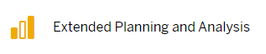
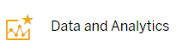




SAP BTP in a Nutshell
Environments
SAP Business Technology Platform Solutions
Open SAP - SAP Business Technology Platform in a Nutshell

Slide 6
Offerings of AI in SAP Landscapes
Why AI Services in SAP?
SAP BTP in a Nutshell
Offerings of AI in SAP Landscapes
Next
SAP AI Business Services
SAP AI Business Services APIs
What’s coming up Next? GenAI?
Take-away

Slide 7
Offerings of AI in SAP Landscapes
AI Business Services
Packaged version of AI-ML Models.
AI Core
AI Launchpad

Slide 8
Offerings of AI in SAP Landscapes
AI Business Services
Packaged version of AI-ML Models.
AI Core
Preconfigured SAP Solutions on ML and open source frameworks
AI Launchpad

Slide 9
Offerings of AI in SAP Landscapes
AI Business Services
Packaged version of AI-ML Models.
AI Core
Preconfigured SAP Solutions on ML and open source frameworks
SaaS Solution in BTP to manage AI use cases in SAP.
- AI Core
AI Launchpad

Slide 10
Offerings of AI in SAP Landscapes
AI Business Services
AI Core
AI Launchpad
HANA PAL
SAC

Slide 11
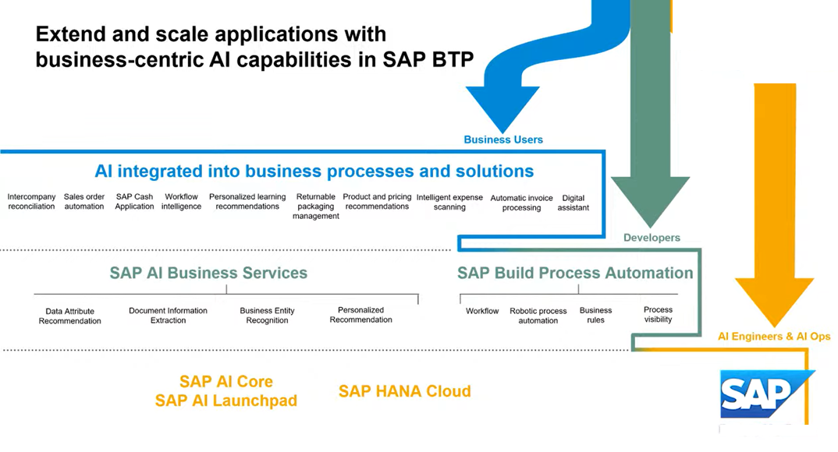
Offerings of AI in SAP Landscapes

Slide 12
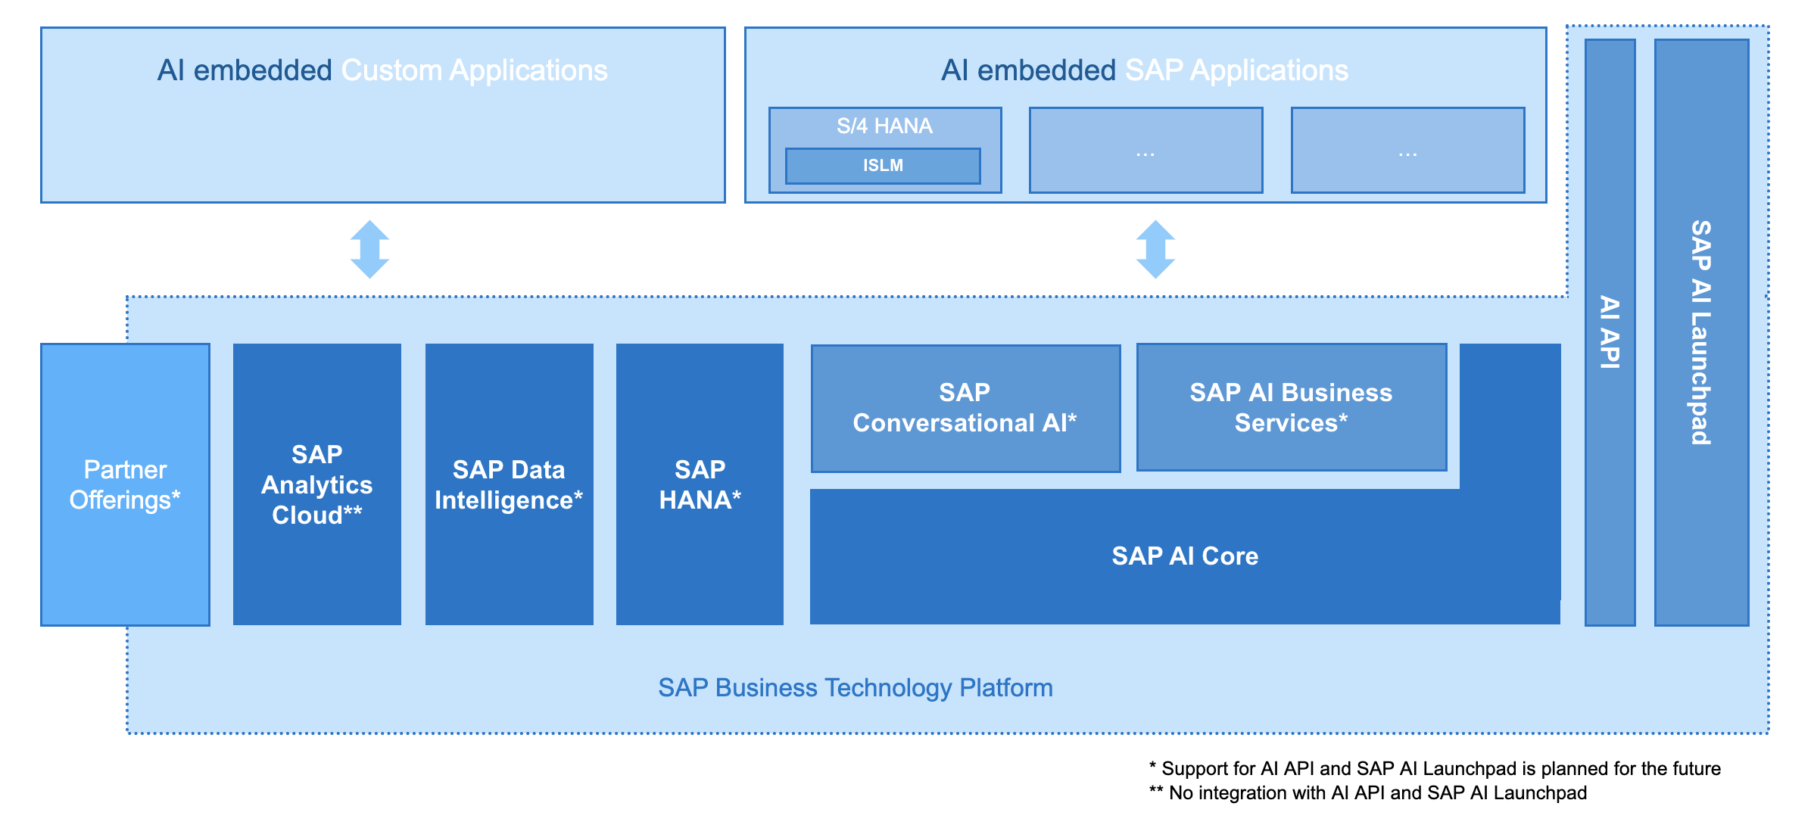
Offerings of AI in SAP Landscapes
Intelligent Scenario Lifecycle Management (ISLM)

Slide 13
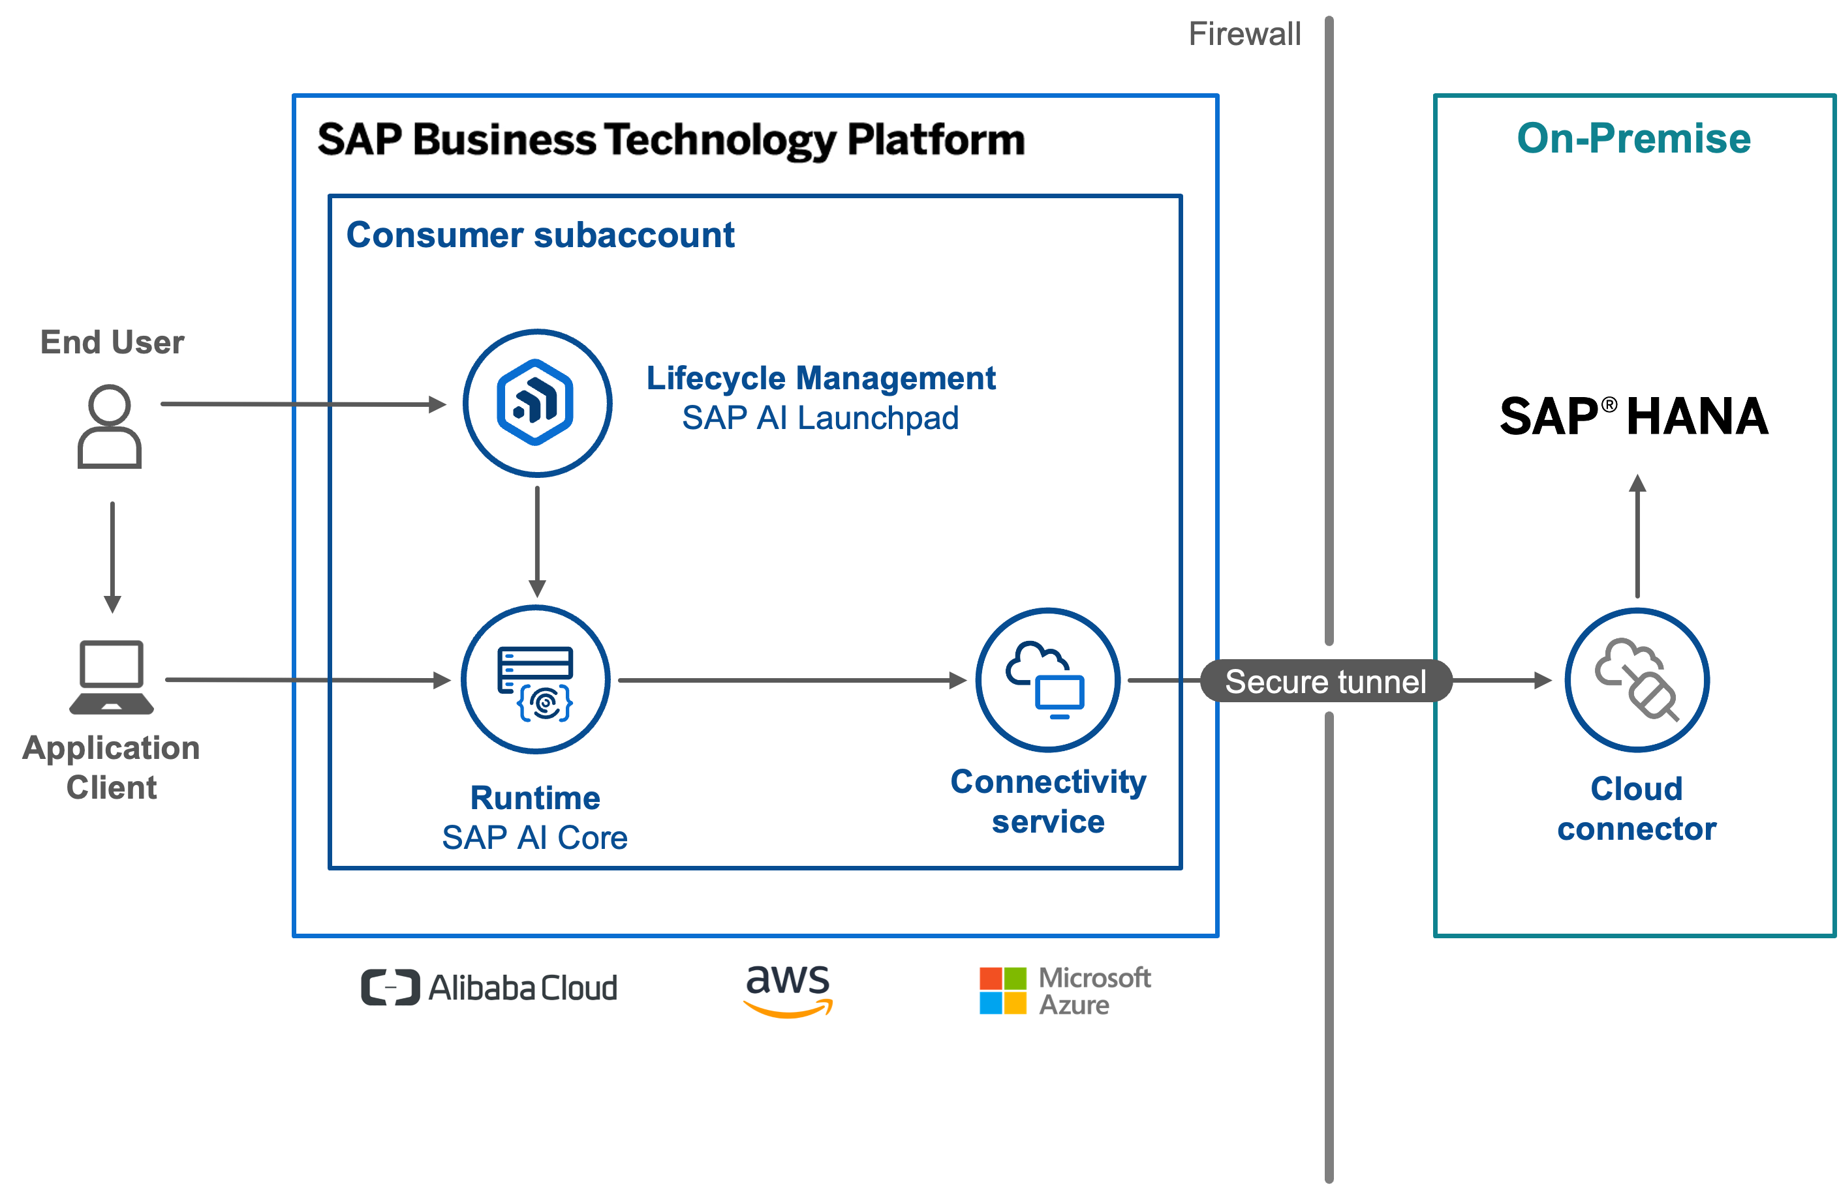
Offerings of AI in SAP Landscapes
AI Core – AI Launchpad: Architecture

Slide 14
SAP AI Business Services
Why AI Services in SAP?
SAP BTP in a Nutshell
Offerings of AI in SAP Landscapes
SAP AI Business Services
Next
SAP AI Business Services APIs
Next
What’s coming up Next? GenAI?
Take-away
AI-Business-Services

Slide 15
SAP AI Business Services
Service Name | Description | Reference
Business Entity Recognition Trial | Helps to understand unstructured Text. Can extract – Contexts from Email, Invoices Numbers. Default model is present to identify different scenarios. Custom Training Can be done with Model. | Business-Entity-Recognition
Personalized Recommendation Free Tier | Personalized Search results, item recommendations | Personalized-Recommendation
Data Attribute Recommendation Trial | Predict the value of missing numerical attributes in your data records. | Data-Attribute-Recommendation
Document Extraction Service Trial | Document Information Extraction helps you to process large amounts of business documents that have content in headers and tables. | Document-Information-Extraction
Service Ticket Intelligence Retiring Soon | Text Classification, Solution Recommendation, Text Clustering | Service-Ticket-Intelligence
Document Translation Service Trial | Translation of Text or File | Document Translation
Document Classification Enterprise | Classifies the document into customer-specific categories | https://help.sap.com/docs/document-classification/document-classification/initial-setup
AI-Business-Services

Slide 16
SAP AI Business Services
Service Name | Description | Reference
Business Entity Recognition Trial | Helps to understand unstructured Text. Can extract – Contexts from Email, Invoices Numbers. Default model is present to identify different scenarios. Custom Training Can be done with Model. | Business-Entity-Recognition
Personalized Recommendation Free Tier | Personalized Search results, item recommendations | Personalized-Recommendation
Data Attribute Recommendation Trial | Predict the value of missing numerical attributes in your data records. | Data-Attribute-Recommendation
Document Extraction Service Trial | Document Information Extraction helps you to process large amounts of business documents that have content in headers and tables. | Document-Information-Extraction
Service Ticket Intelligence Retiring Soon | Text Classification, Solution Recommendation, Text Clustering | Service-Ticket-Intelligence
Document Translation Service Trial | Translation of Text or File | Document Translation
Document Classification Enterprise | Classifies the document into customer-specific categories | https://help.sap.com/docs/document-classification/document-classification/initial-setup
AI-Business-Services

Slide 17
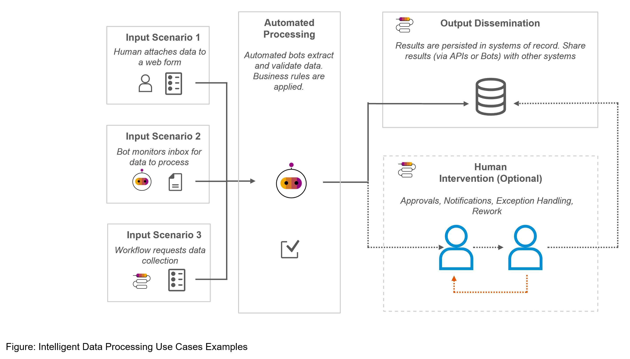
SAP AI Business Services
Automation understanding

Slide 18
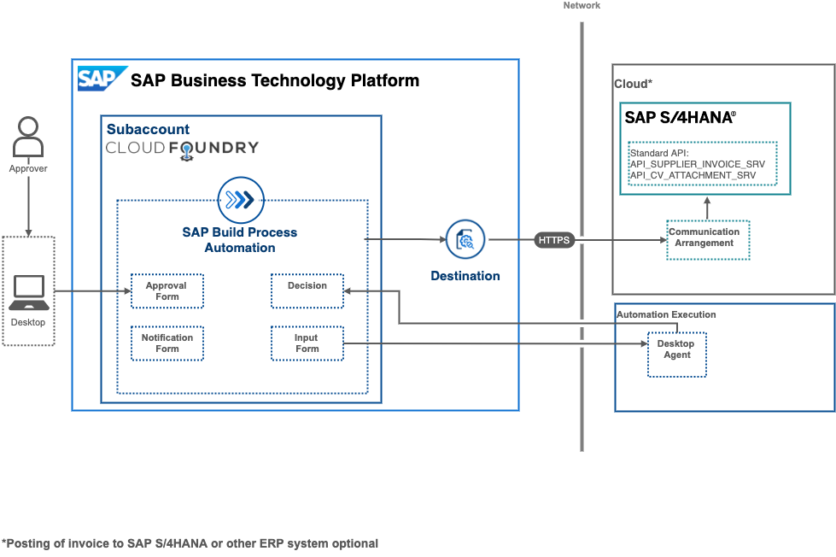
SAP AI Business Services
With Build Process Automation

Slide 19

What is Cloud?

Slide 20


Slide 21
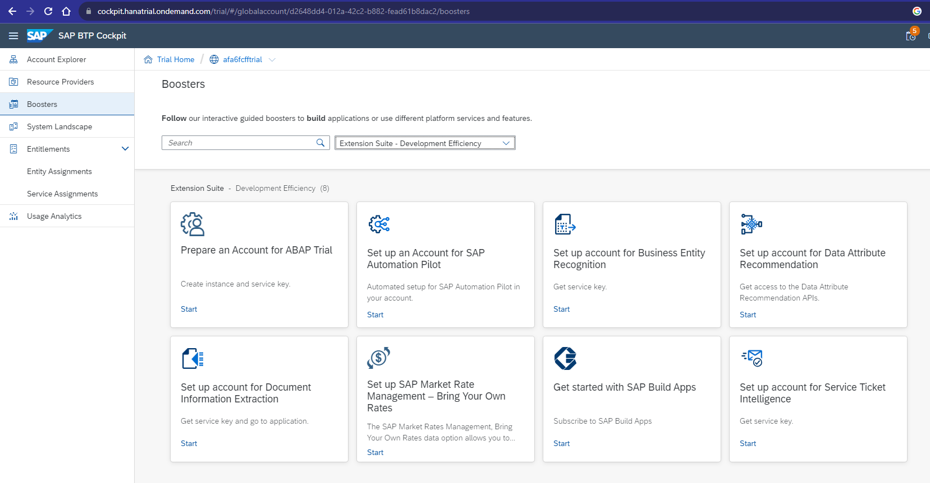
SAP AI Business Services
Subaccount
Boosters
Extension Suite – Development Efficiency

Slide 22
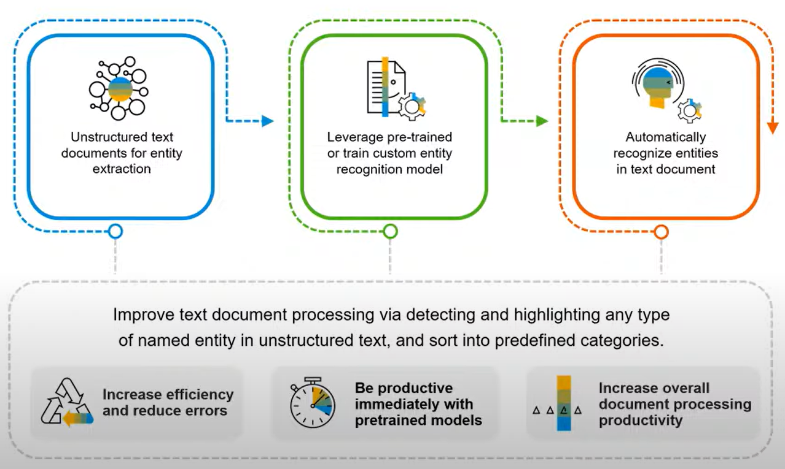
SAP AI Business Services
Business Entity Recognition

Slide 23
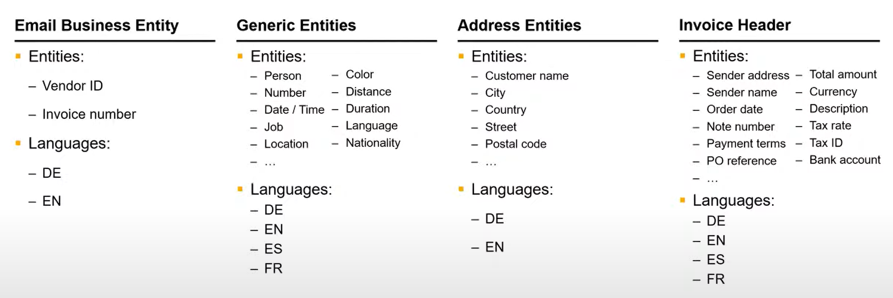
SAP AI Business Services
Business Entity Recognition

Slide 24
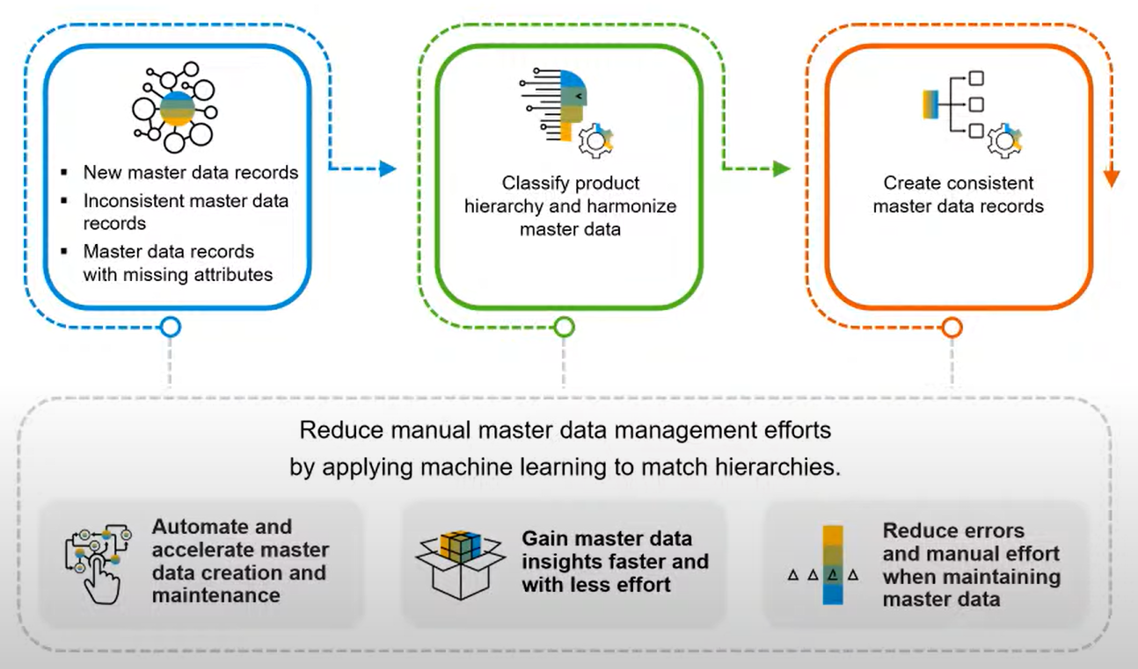
SAP AI Business Services
Data Attribute Recommendation

Slide 25
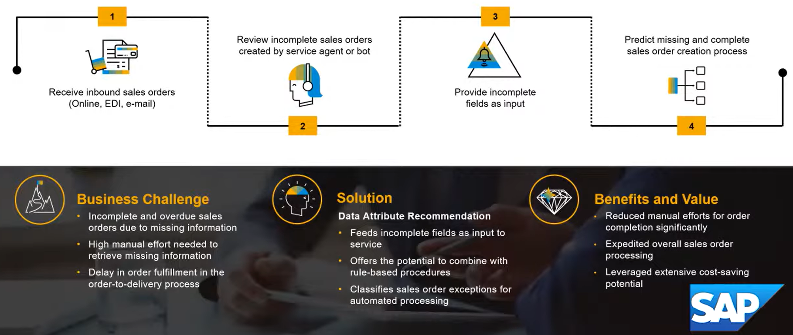
SAP AI Business Services
Data Attribute Recommendation

Slide 26
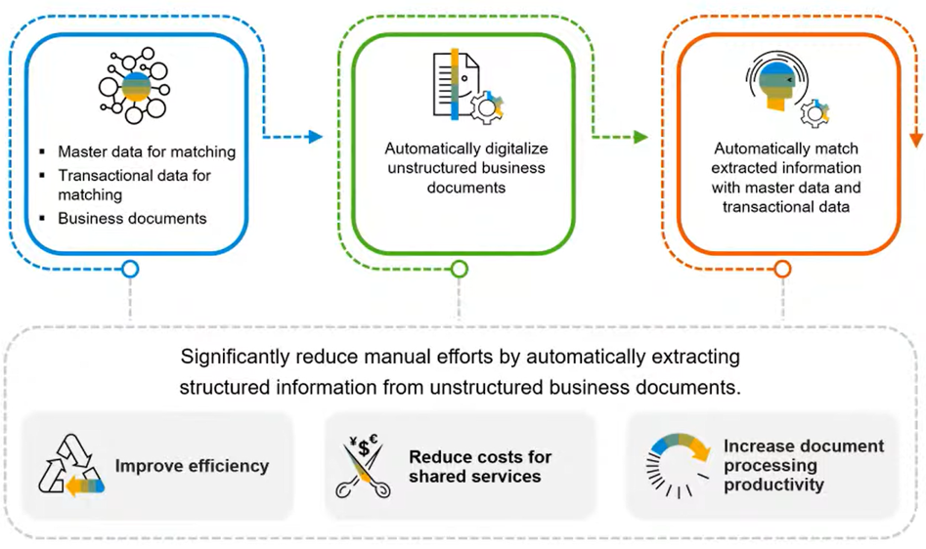
SAP AI Business Services
Invoice Process - Document Extraction Service
DOX-UI

Slide 27
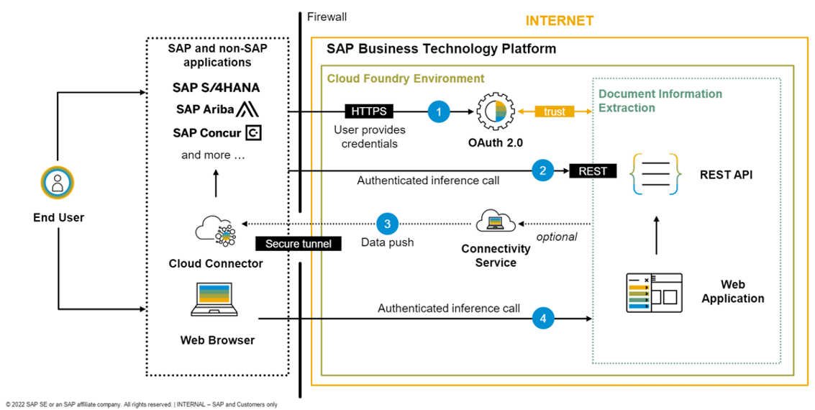
SAP AI Business Services
Integration architecture

Slide 28
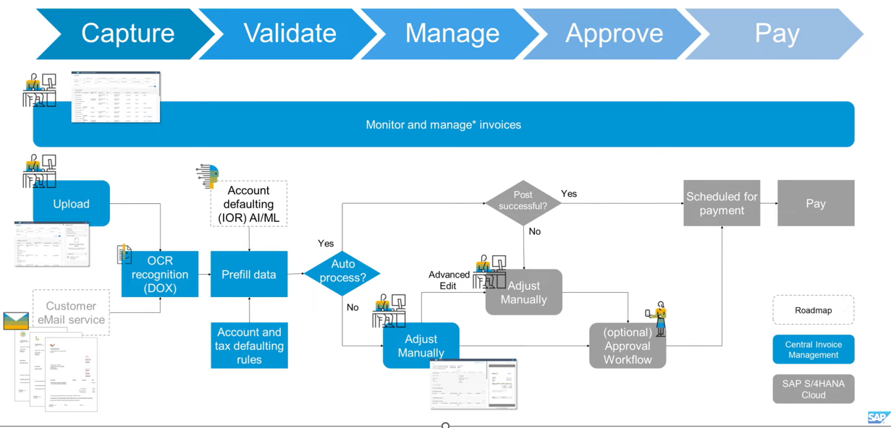
SAP AI Business Services
Example - SAP Central Invoice Management

Slide 29
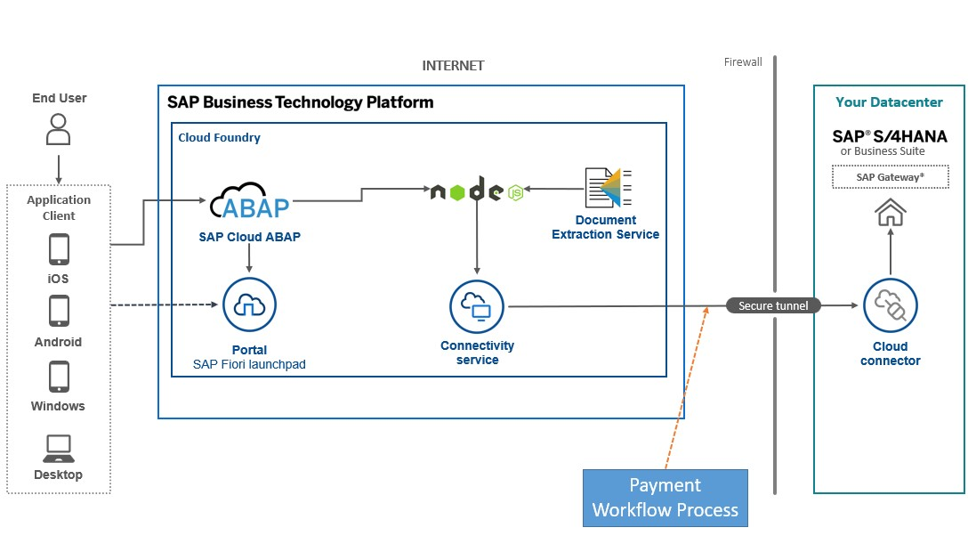
SAP AI Business Services
Example - SAP Vendor Invoice Management - Custom

Slide 30
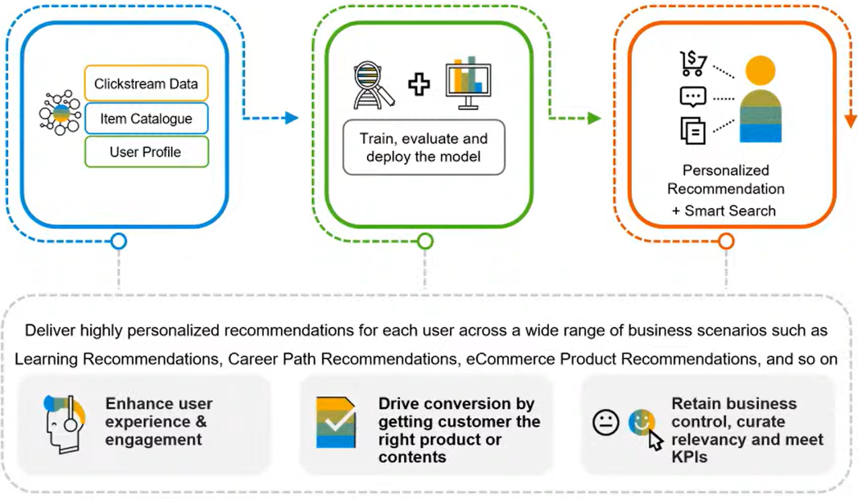
SAP AI Business Services
Personalized Recommendation

Slide 31
What’s coming up Next? GenAI?
Why AI Services in SAP?
SAP BTP in a Nutshell
Offerings of AI in SAP Landscapes
SAP AI Business Services
SAP AI Business Services APIs
What’s coming up Next? GenAI?
Next
Take-away

Slide 32









What’s coming up Next? GenAI?
Customer
SAP Business Technology Platform
Send Purchase Order with Email
Creation of Sales Order
PO Acknow.
Email Generation
PDF to JSON Conversion
ChatPDF
Sales Order for Purchase Order
Generative AI
Cognitive AI
Generative AI
Customer
Notes:
https://www.youtube.com/watch?v=ucZFrONCVZ4

Slide 33









What’s coming up Next? GenAI?
SAP Business Technology Platform
Customer
VDI
Propagator Middleware
Send Purchase Order with Email
Creation of Sales Order
PDF to JSON Conversion
Email Generation
PO Acknow.
ChatPDF
Sales Order for Purchase Order
Generative AI
Cognitive AI
Generative AI
Customer
Notes:
https://www.youtube.com/watch?v=ucZFrONCVZ4

Slide 34
Take-away
Why AI Services in SAP?
SAP BTP in a Nutshell
Offerings of AI in SAP Landscapes
SAP AI Business Services
SAP AI Business Services APIs
What’s coming up Next? GenAI?
Take-away
Next

Slide 35
SAP AI Business Services
Scenarios
Customer PO - EMAIL
Read PDF and Create SO in S4
EMAIL response to Customer with SO
Vendor Invoice EMAIL
Read PDF and Financial Postings in S4
EMAIL response to Vendor with Posting

Slide 36
Take away
BTP
AI
AI Business Services
Integrations
Node-RED
Ngrok
Build Process Automation
Estimator
BA HUB
Discovery
SCN
https://help.sap.com/docs/data-attribute-recommendation

Slide 37
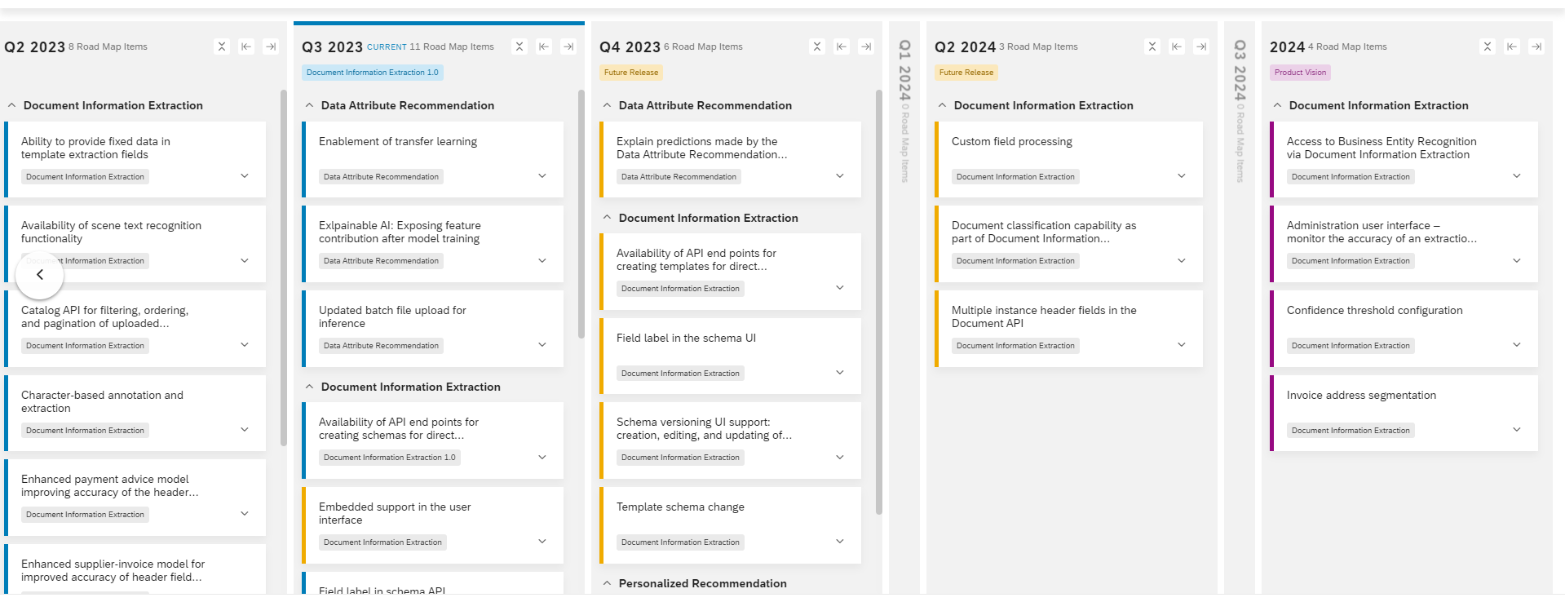
AI Business Services - RoadMap

Slide 38
Python Libraries
https://pypi.org/project/ai-api-client-sdk/
Service | Python SDK
Data Attribute Recognition | https://github.com/SAP/data-attribute-recommendation-python-sdk
Business-entity-recognition | https://github.com/SAP/business-entity-recognition-client-library
Notes:
https://www.youtube.com/watch?v=ucZFrONCVZ4

Slide 39
Notes:
https://www.youtube.com/watch?v=ucZFrONCVZ4

